Slide 1

N-Body Simulation
Fabian Hölzl, Nicolas Sierra Manrique
Technische Universität München
Garching, 03. July 2025

Slide 2
Outline
Introduction to N-Body Problems
Physics for Stellar Systems
Interaction Methods
Position Integration Methods
Nvidia’s N-Body Algorithm
Code Samples
Performance
Visual Examples

Slide 3
Introduction to N-Body Problems
-multiple bodies interacting with each other based on some physical law -> forces between each particle
-> e.g. gravitation or molecular dynamics (dna/protein interactions, protein folding)

Slide 4
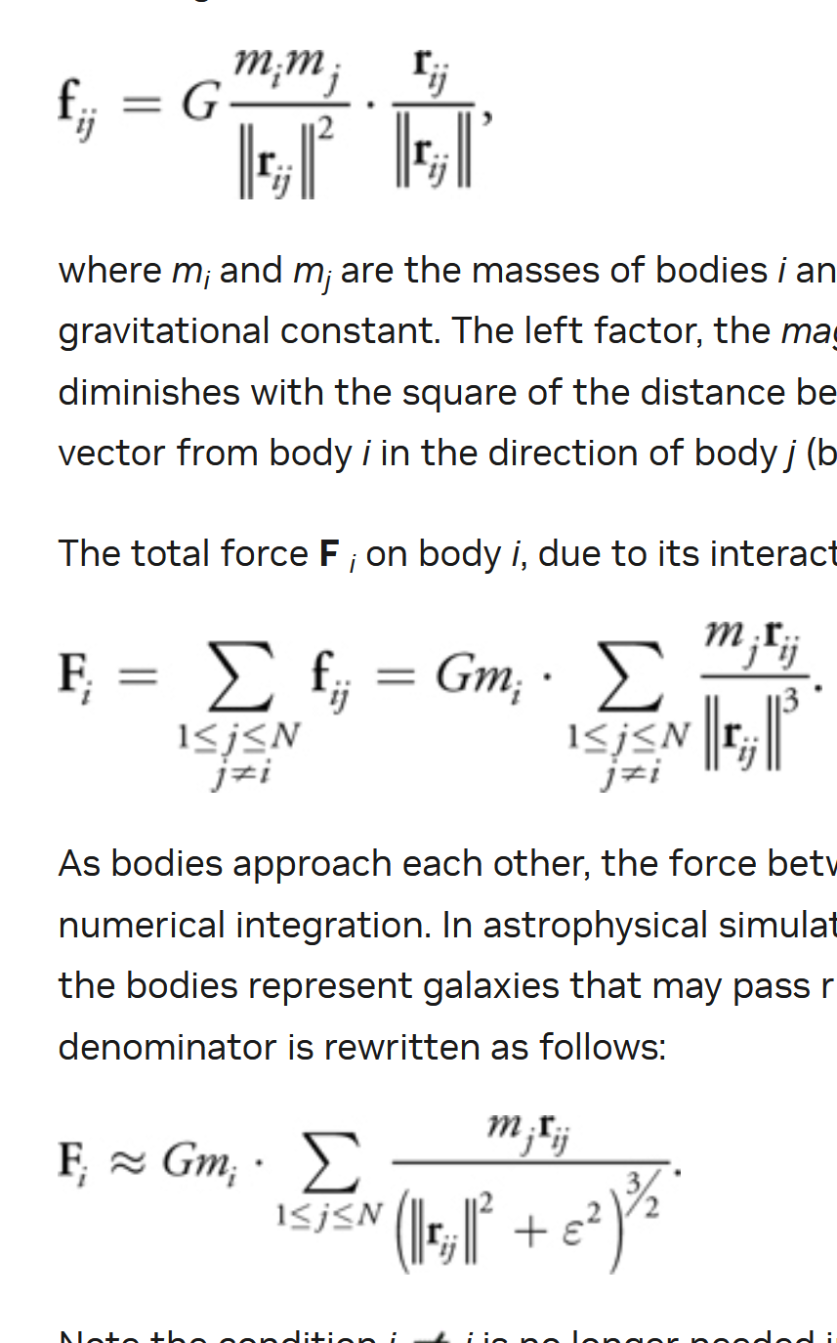
Physics for Stellar Systems
Explain gravitational interaction (mostly from “31.2 All-Pairs N-Body Simulation
“ Gem3)
And explain softening factor

Slide 5
Interaction Methods
All-pairs method
Barent-hut?
Other? (see nvida gem3 bottom)

Slide 6
Position Integration Methods
Euler method
Leapfrog
Verlet
(Leapfrog or Verlet first)?

Slide 7
Nvidia’s N-Body Algorithm
Explain NxN matrix and tiling of said matrix in general just explaining nvidias gem3

Slide 8
Code Samples
Pics of nvidas kernel and device functions some explanations
Some information on self written code, how these functions where implemented in own code

Slide 9
Performance
Performance/Plots on how simulation parameters where chosen
Performance compairision between gpus
Performance compairision between self written code and nvidia sample

Slide 10
Visual Examples
Some videos of nvidia visualization how it could look like

Slide 11
Farben
Als erstes soll mit schwarz und weiß gearbeitet werden. Für Aufwändigere Darstellungen sind Farben mit Bedacht und in möglichst geringem Umfang einzusetzen. In diesem Folienmaster ist die Farbpalette festgelegt.
Zuerst mit den Primärfarben arbeiten.
Für z.B. komplexe Diagramme stehen noch Sekundärfarben zur Verfügung.
Gering im Einsatz sind die Akzentfarben.

Slide 12
References
[1] https://developer.nvidia.com/gpugems/gpugems3/part-v-physics-simulation/chapter-31-fast-n-body-simulation-cuda

